Slide 2

Data Presentation for Everyone: Simple Ways to Educate without Teaching
Allison Sliter
QA Researcher
@allisons (Twitter and Github)

Slide 3
Overview
Center Your Audience
Who is your audience?
Start with guiding questions
Use plain language
Do the Work For Them
Label Everything
Make aesthetic choices that support intuitive understanding.
Choose the Right Plot
End On a Clear Note
Big Takeaway
Next Steps

Slide 4
Centering Your Audience

Slide 5
Exercise for the Audience
What are the appropriate cases for the following tests and what assumptions does your data have to meet?
Test Name | Application | Assumptions
Chi-Squared Test of Independence
Two-Way Anova ANOVA
Paired Sample T-Test
Wilcoxon signed-rank test

Slide 6

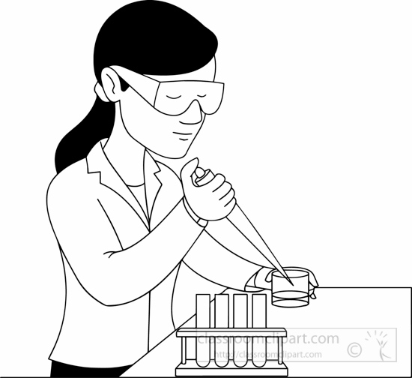


Who Is Your Audience, what do they need to learn from you, what do you need to learn from them?
My audiences include:
Managers
Subject Matter Experts
Software Developers
Stakeholders from Sales and Marketing
Start with guiding questions!

Slide 7
Use Plain Language
Instead of… | Try…
Statistically Significant | “If we did this experiment again, it would be unlikely to come up with a different result”
Null Result | “We haven’t gotten enough data to answer your question. More data may help.”
Confidence Interval | “We’re pretty sure the true answer is between this and that.”
p-value | Maybe skip talking about p-values at all?
More guidance here: https://www.plainlanguage.gov/guidelines

Slide 8
Do the Work For Your Audience

Slide 9
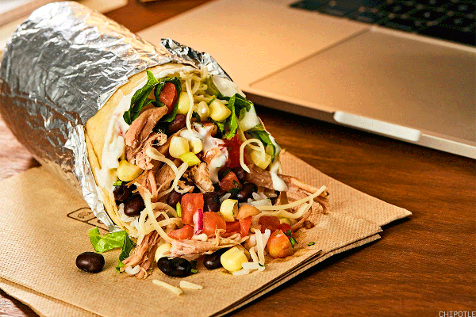
Consider the burrito

Slide 10
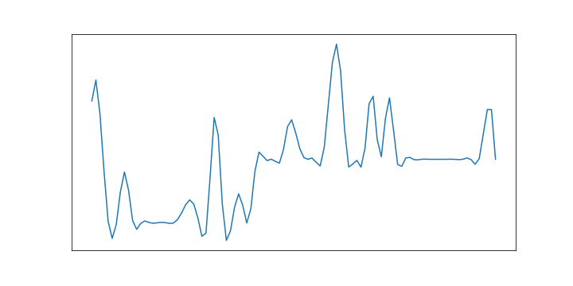
Label Everything

Slide 11
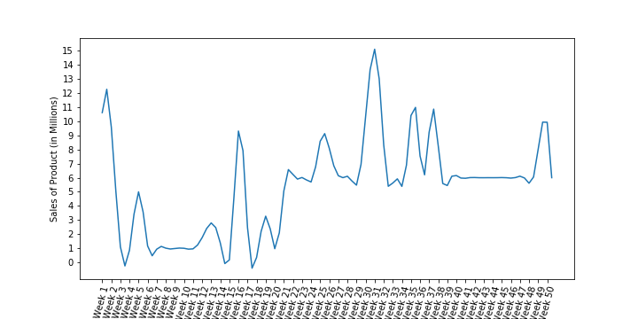
Label Everything

Slide 12
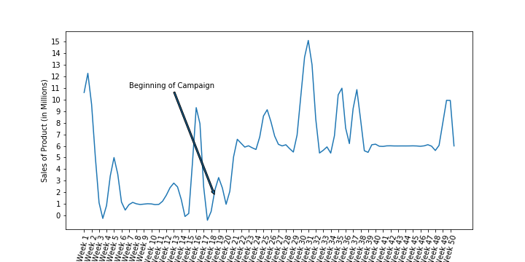
Label Everything

Slide 13
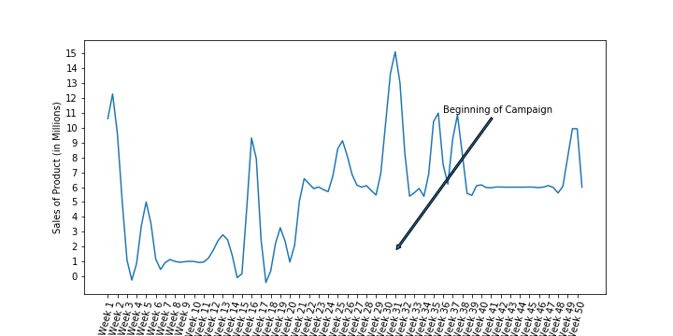
Label Everything

Slide 14
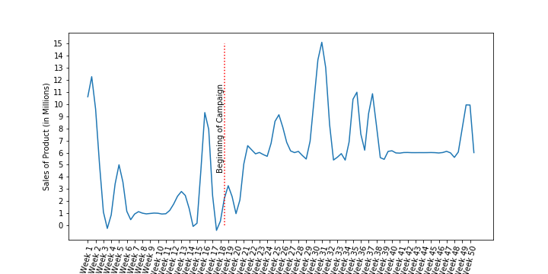
Label Everything

Slide 15
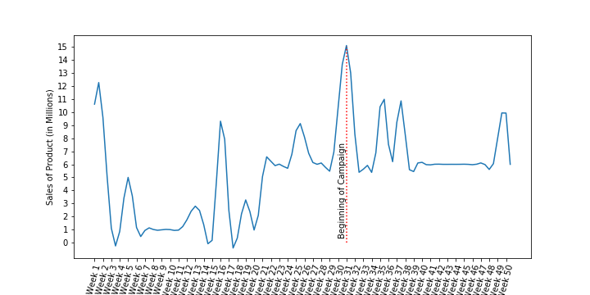
Label Everything

Slide 16
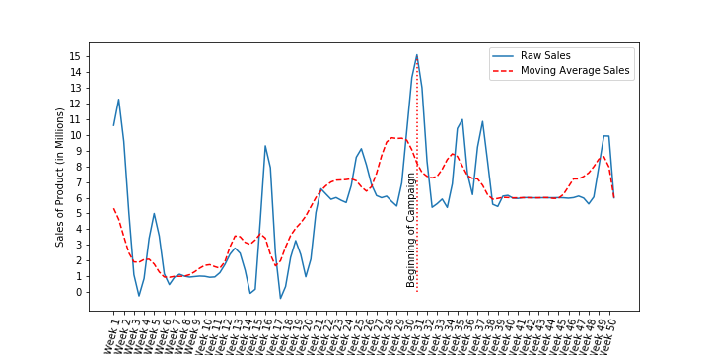
Label Everything

Slide 17
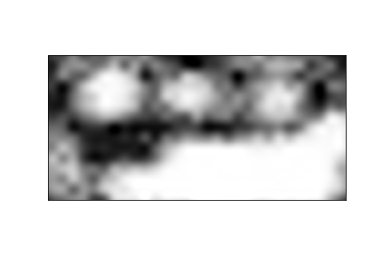
Choosing Aesthetics to Support Intuitive Understanding

Slide 18
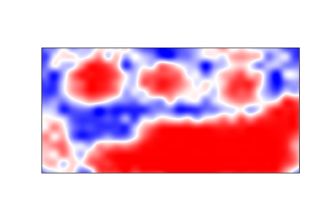
Choosing Aesthetics to Support Intuitive Understanding

Slide 19
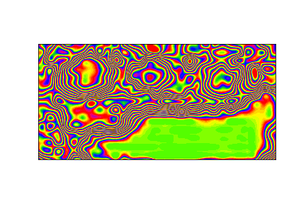
Choosing Aesthetics to Support Intuitive Understanding

Slide 20
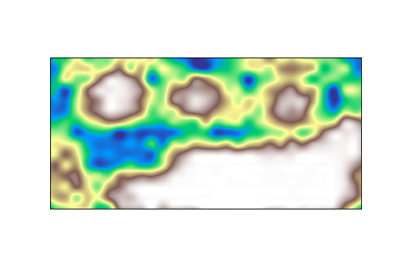
Choosing Aesthetics to Support Intuitive Understanding

Slide 21
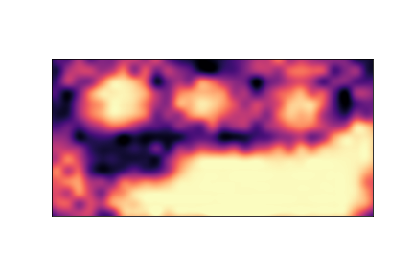
Choosing Aesthetics to Support Intuitive Understanding

Slide 22
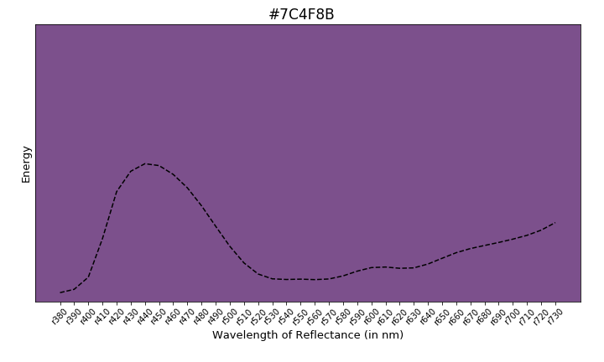
Examples of “Audience Centered” Plots

Slide 23
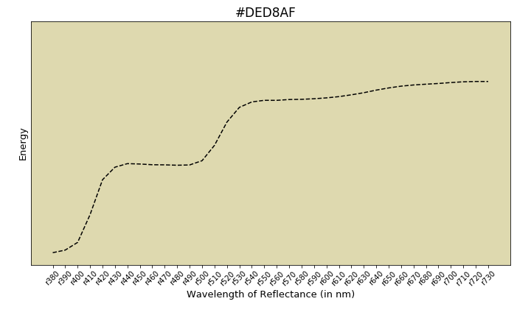
Examples of “Audience Centered” Plots

Slide 24
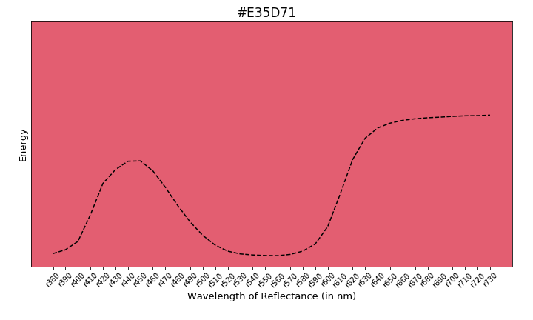
Examples of “Audience Centered” Plots

Slide 25
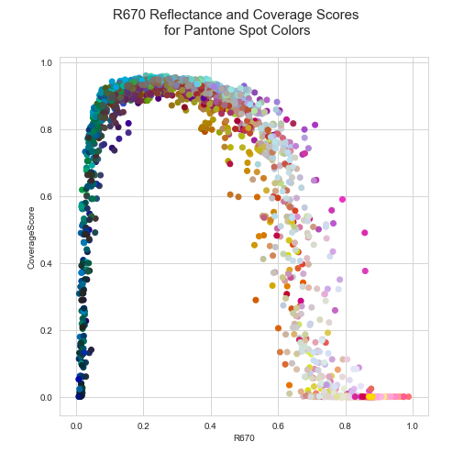
Examples of “Audience Centered” Plots

Slide 26
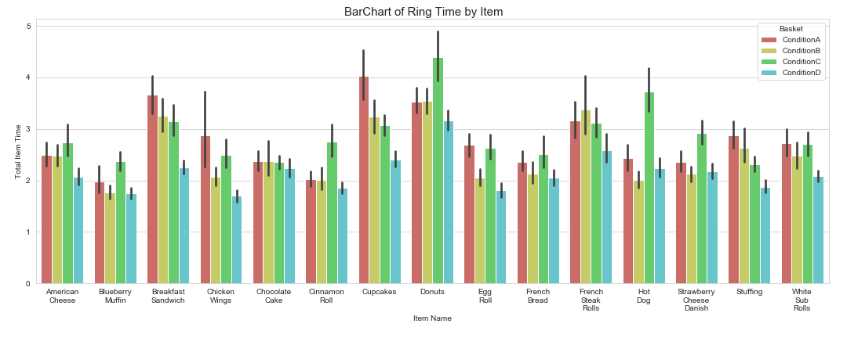
Choosing the Right Plot

Slide 27
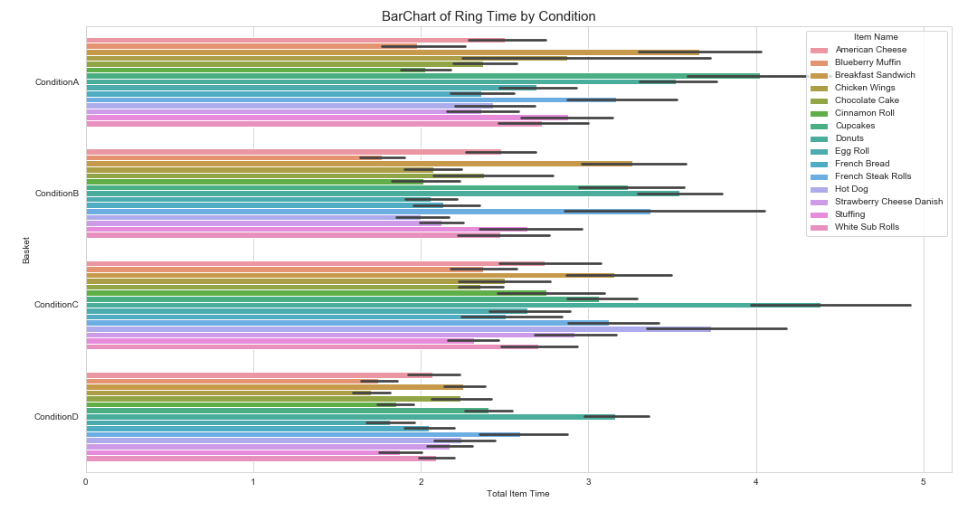
Choosing the Right Plot

Slide 28
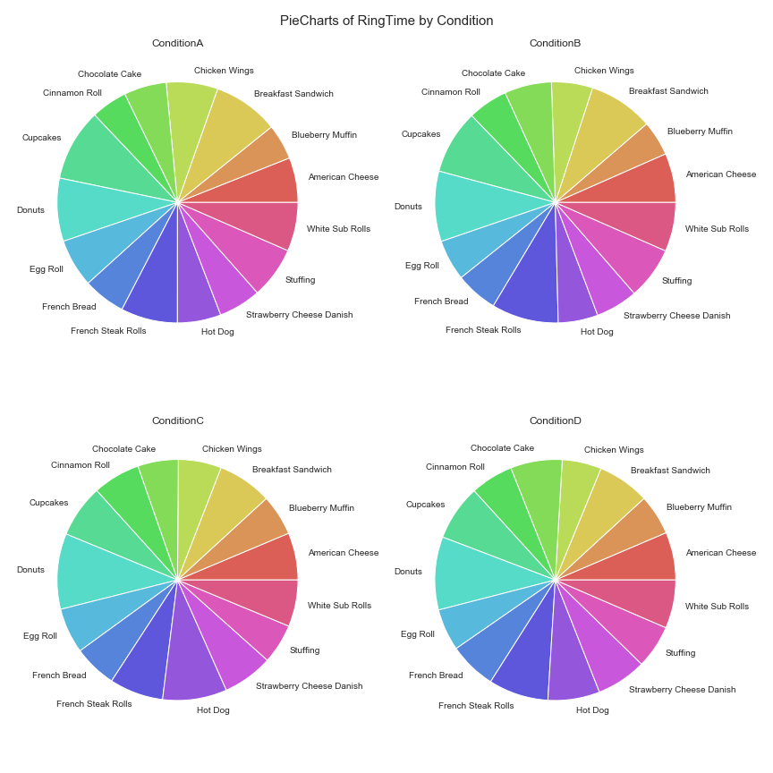
Choosing the Right Plot

Slide 29
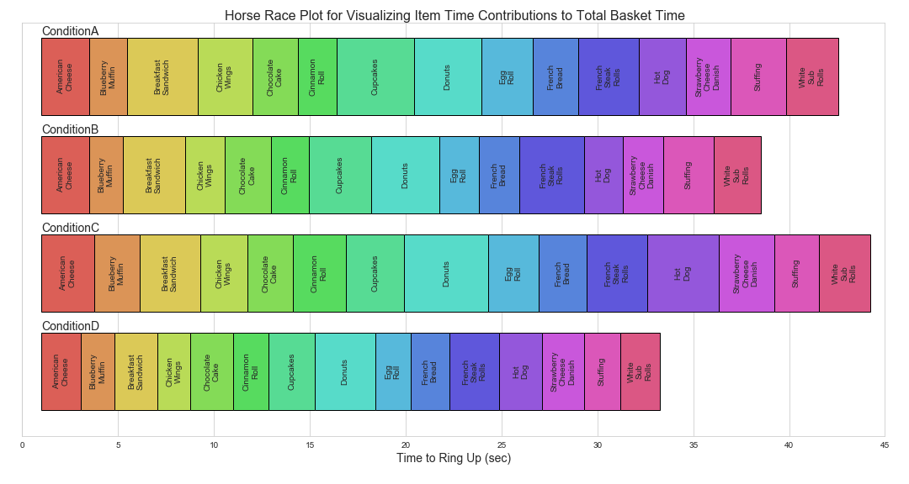
Choosing the Right Plot

Slide 30
End on a Clear Note

Slide 31
Division of Labor
Your Job | Their Job
Know enough about the question and the data to pick the right statistical inference test. | Help you form guiding questions
Decide what the critical level should be. | Listen to what the data scientist is saying
Do all the data exploration ahead of time so you know all the patterns and hidden pitfalls. | Act On It
Design audience-centered plots.
Document your whole process in reference material to be provided upon request.
Present the clearest, cleanest answer you can.

Slide 32
Further Reading
Cleveland, W. S., & McGill, R. (1984). Graphical perception: Theory, experimentation, and application to the development of graphical methods. Journal of the American statistical association, 79(387), 531-554.
Kahneman, D. (2011). Thinking, fast and slow. New York: Farrar, Straus and Giroux.
Tufte, Edward R., 1942-. (2001). The visual display of quantitative information. Cheshire, Conn. :Graphics Press,
Notebook of the visualizations I included in this presentation available in a binder at https://github.com/allisons/SDSSDataPresentation

Slide 33
Thank You

